Slide 1
POWERPOINT
TEMPLATE
上海路嘉胶粘剂有限公司简介
Shanghai Rocky Adhesives Co., LTD
Company Introduction
Filter products industry introduction
www.shrocky.com

Slide 2
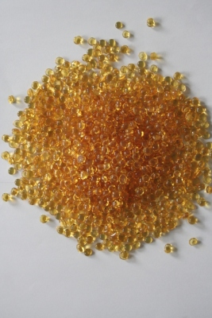
Application of filter
Hot melt adhesive for air filter
Hot melt adhesive for fuel filter

Slide 3
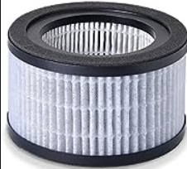
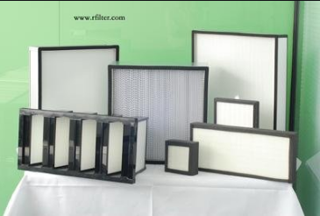
1.EVA Hot melt adhesive for air filter
Application of filter
Main model：
RY16202 Yellow color for filter linear
RY16201 White color for filter linear
RY16120 Yellow color for filter frame
RY23406 Water based adhesive for filter frame

Slide 4
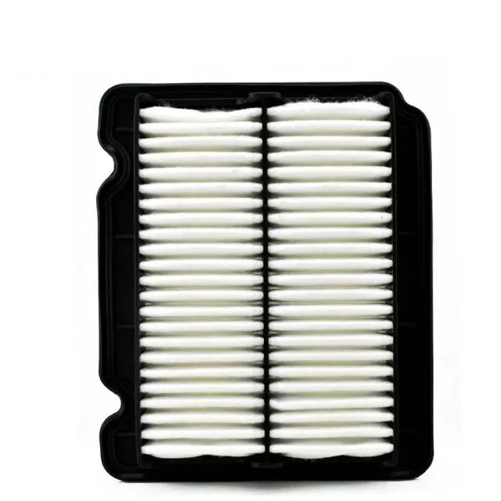
Application of filter
2.(APAO) Adhesive for air filter
Features：Green，good aging resistance,high bonding strength and exellent resistance to high and low temperatures.
Main model：
RY15113
RY15016

Slide 5
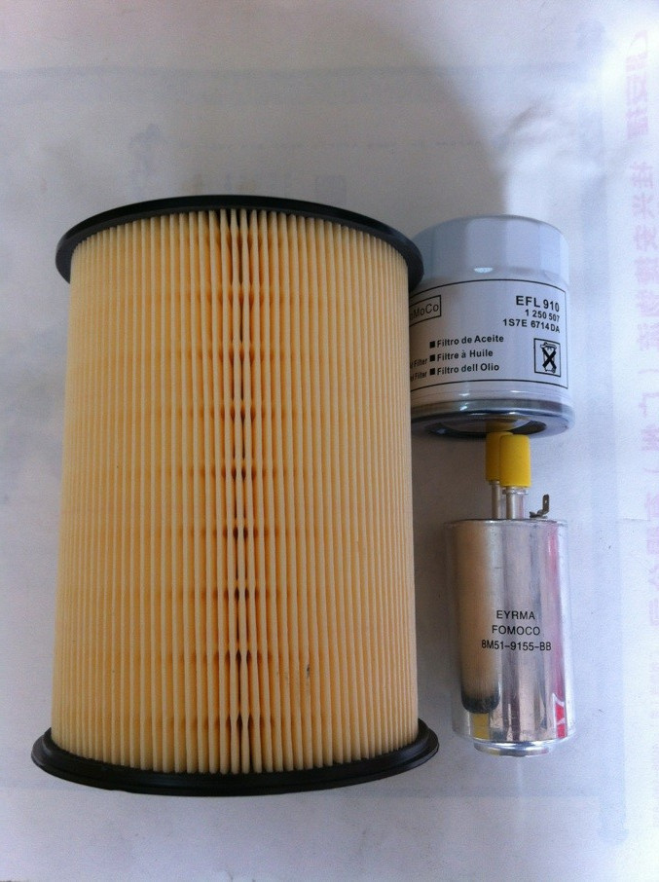
Application of filter
3.（PA）Adhesive for automatic filter
Features：Green，good initial adhesion,peeling force and endurance, good aging resistance and exellent resistance to high and low temperatures.
Main model：
RY15073
RY15054

Slide 6
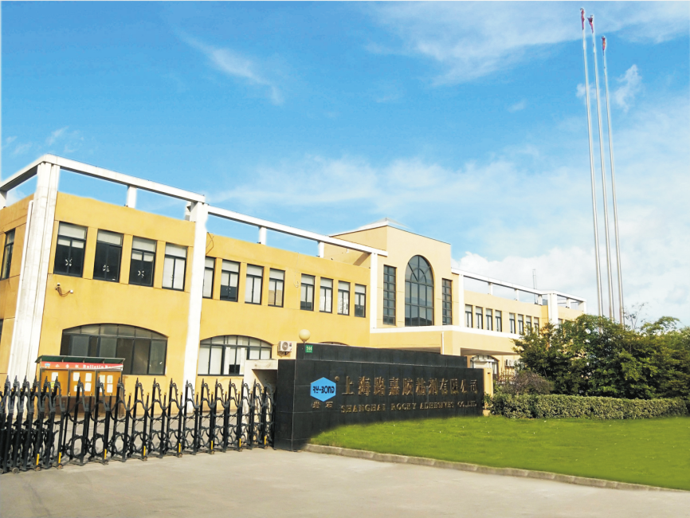
Thanks for your attention
01
02
03
04
Contact us：
Tel：+86-020-59761668
Address：566 Huaxu Road, Xujing Town, Qingpu District, Shanghai, China

Slide 7
Thank you！

