Slide 1
Company name
山东元禾新材料科技股份有限公司
SHANDONG YUANHE NEW MATERIALS TECHNOLOGY SHARE HOLDING CO.,LTD
SILANE COUPLING AGENT R＆D PRODUCTION EXPERT

Slide 2
MENU
01
02
03
ABOUT US
PROUCT AND SERVICE
CULTURE

Slide 3
Shandong Yuanhe New Material Technology Shareholding Co., Ltd., mainly engaged in the research, manufacture and sales of rubber addictive such as functional silanes and rubber pre-dispersed masterbatch, was established in 2009. Our products are widely used in vehicle tyres, rubber products industries. It is a specialization and special new enterprise in Shandong Province, a national high-tech enterprise.Our headquarter, which covers an area of production base more than 20 acres and has over one hundred employees, is located in Dezhou city.
1. Our Main Business
Our main business is dedicated to the research, manufacture and sales of rubber addictive such as functional silanes and rubber pre-dispersed masterbatch. Yuanhe has a circular economic system and one of the leading industrial scale enterprises in the world, especially in the segment of sulfur-silanes. Currently, we cooperate with the world's top ten foreign rubber tire companies such as Kumho Tire, Hankook Tire,Pirelli Tire, and Kenda Rubber, as well as more than ten domestic rubber tire enterprises such as Qingdao Double Star Tire, Aeolus Tire, Haida Rubber Group, and Guizhou Tire.Our main products are Rubber additives and Silane coupling agents. Such as YH-69&HRH-69 (Silane 69), YH-75/HRH-75 (Silane 75), KH550, Pre-dispersed Rubber Masterbatch (Silane) Si-50, Pyrolysis carbon black, etc. Our company is ISO9001 and ISO14001 certified enterprise.
About us

Slide 4
2. Research and Innovation
Our company focuses on technological innovation and new product research and development, and has established long-term cooperation with well-known universities and laboratories such as Beijing University and Shandong University. It actively promotes the research and development and application of new products and new technologies. We now have 20 invention patents and have established own intellectual property system. Our company was rated as a national high-tech enterprise in 2018, a "One Company, One Technology" enterprise of Dezhou City in 2019, and “SRDI Enterprise”(Specialized, Refinement, Differential, Inovation) of Shandong Province in 2022. Also in 2022, our company established Shandong Guoxiang Rubber Technology Co., Ltd. and conducted in depth cooperation with relevant institutions of Dezhou University and Qingdao University to conduct new material technology research and development, technical services and technical consulting work in rubber additives.
About us

Slide 5
EVENTS
Investment in Trichlorosilane Production.
2013：Started to produce solid silane coupling agent 。
Start Production of intermediate Silane
2007
2010
2013
2009
2012
Process Reformation of CPTCS and CPTES, Silane Intermediate Supplying kept increasing. Passed ISO9001:2008 certification.
Start production of Silane coupling agents. Silane Annual Sales Reached to 30 million RMB.

Slide 6
EVENTS
The new intermediate workshop put into production, most of the by-products have been recycled.
PassedISO14001:2015 certification
Carbon Black N660 inJixi factory and Pyrolysis Carbon Black in Shanxi factory started into producing
2014
2017
2022
2015
2018
Silane Annual Sales increased to 50 million RMB.
The new solid production line is put into operation.

Slide 7
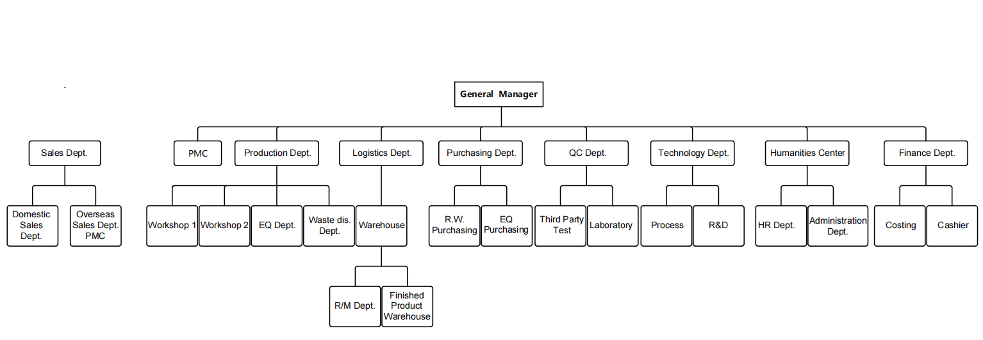
Organization Structure
01
您的内容打在这里，或者通过复制您的文本后，在此框中选择粘贴，并选择只保留文字。
您的内容打在这里，或者通过复制您的文本后，在此框中选择粘贴，并选择只保留文字。
02
您的内容打在这里，或者通过复制您的文本后，在此框中选择粘贴，并选择只保留文字。
您的内容打在这里，或者通过复制您的文本后，在此框中选择粘贴，并选择只保留文字。
03
您的内容打在这里，或者通过复制您的文本后，在此框中选择粘贴，并选择只保留文字。
您的内容打在这里，或者通过复制您的文本后，在此框中选择粘贴，并选择只保留文字。
04

Slide 8
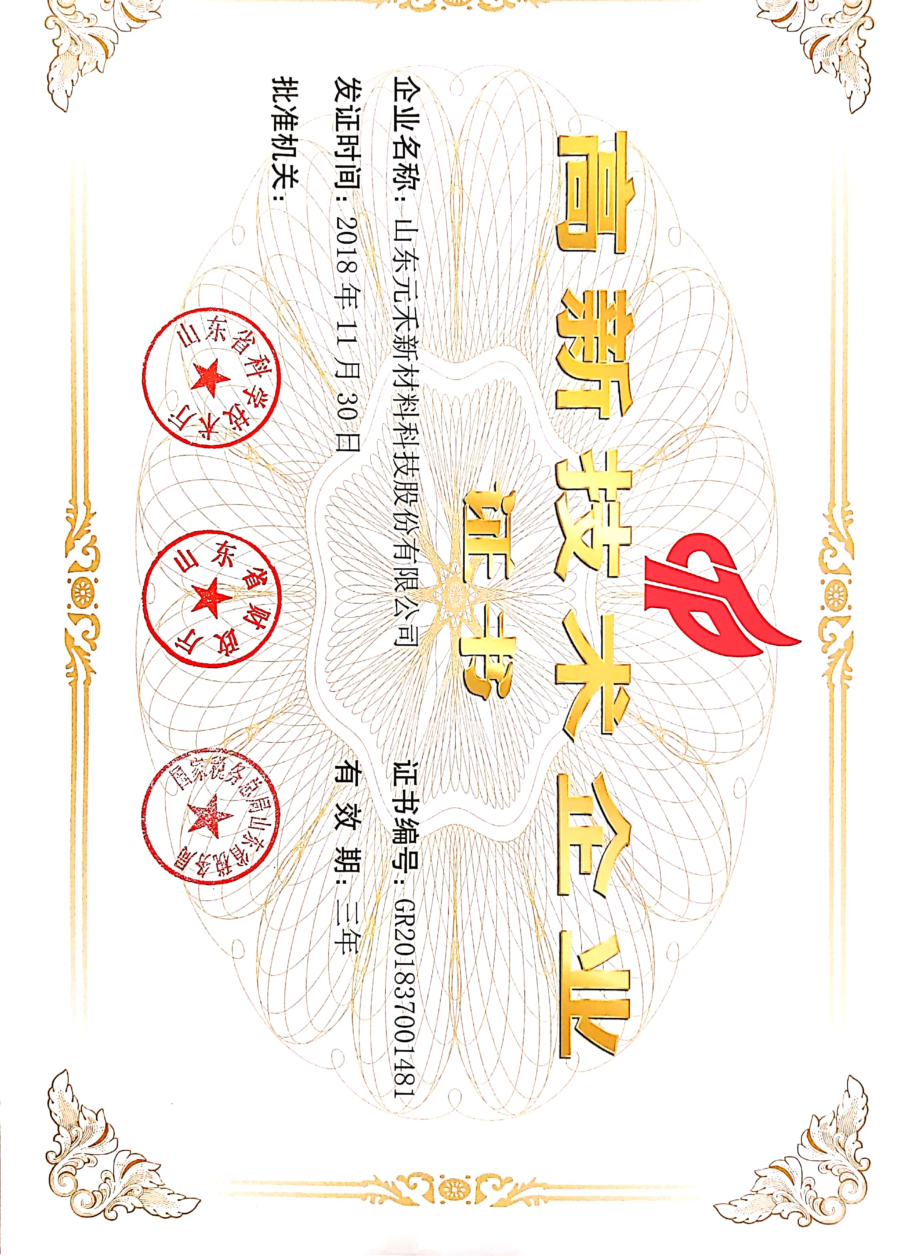

Slide 9
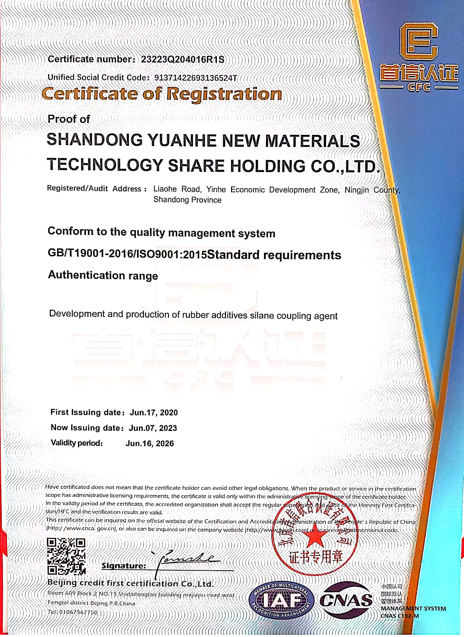

Slide 10
02
PRODUCT AND SERVICE

Slide 11
PRODUCT LIST
Product Code | CAS No. | English Name | Chemical Name
硅烷偶联剂YH-69 | 40372-72-3 | Silanecoupling agent YH-69 | Bis-[3-(triethoxysilyl)-propyl]-tetrasulfide
硅烷偶联剂HRH-69 | 40372-72-3 | Silane coupling agent HRH-69 | Bis-[3-(triethoxysilyl)-propyl]-tetrasulfide&Carbon black N330 mixture
硅烷偶联剂YH-75 | 56706-10-6 | Silane coupling agent YH-75 | Bis-(γ-triethoxysilylpropyl)-disulfide
硅烷偶联剂HRH-75 | 56706-10-6 | Silane coupling agent HRH-75 | Bis-(γ-triethoxysilylpropyl)-disulfide&Carbon black N330 mixture
硅烷偶联剂KH-550 | 919-30-2 | Silane coupling agent KH550 | Aminopropyltriethoxysilane
环保热裂解炭黑YH-7330/YH-7660 | 1333-86-4 | Pyrolysis carbon blackYH-7330/YH-7660 | Pyrolysis carbon black
炭黑N234/N330/N660 | 1333-86-4 | Carbon black N234/N330/N660 | Carbon black
硅烷母胶粒Si-50 | N/A | Pre-dispersed Rubber Masterbatch (Silane) Si-50 | An exclusive pre-dispersed 50% Bis-[3-(triethoxysilyl)-propyl]-tetrasulfide in a 50% elastomeric and filler(elastomeric is EPDM).
硫磺母胶粒S-80 | N/A | Pre-dispersed Rubber Masterbatch (Sulfur) S-80 | Sulfur 80% 20%EPDM

73%
17%


Slide 12
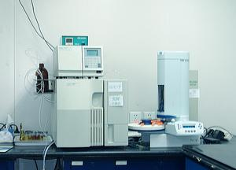
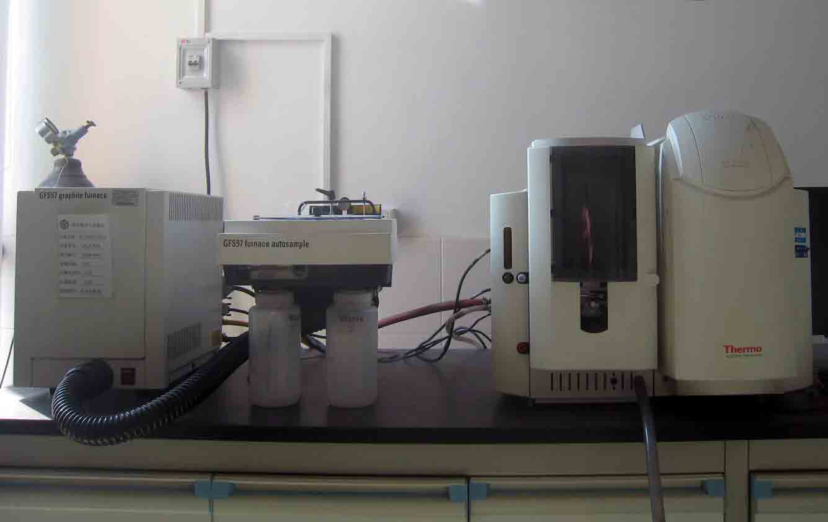
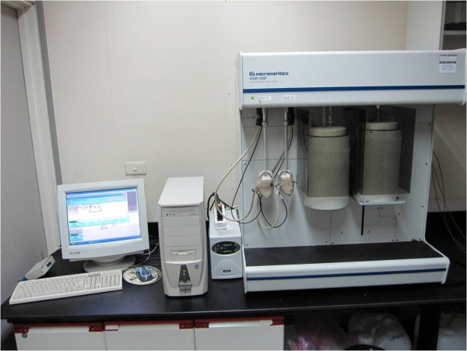
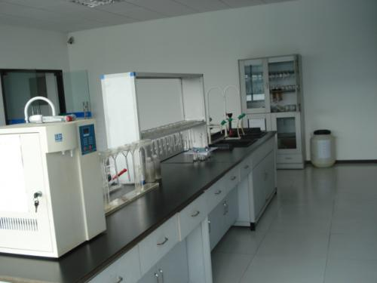
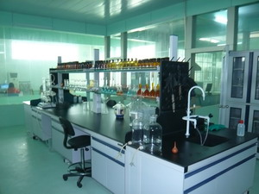
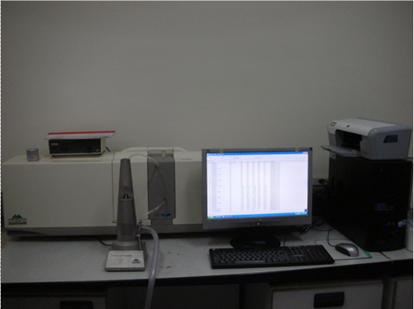
Quality contral
Test equipment
HPLC
AAS
BET apparatus
Inorganic analysis room
PDA
Analysis room

Slide 13
合作客户
KUMHO TIRE CO.,INC
DOUBLE STAR TIRE CO.,LTD
WUCHAN ZHONGDA CHEMICAL GROUP CO.,LTD
LINGLONG TIRE CO.,LTD
AEOLUS TIRE CO.,LTD
DOUBLE COIN GROUP
GUIZHOU TIRE CO.,LTD

Slide 14
03
ENTERPRISE CULTURE

Slide 15
Srategy and objectives
03
04
PROCUTION&SCALE EXPANSION
ENHANCE UNDERSTANDING OF SILANE APPLICATIONS
02
EFFICIENCY
SAFTTY
ENVIRONMENTAL PROTECTION
05
ENTERPRISE IMAGE PROMOTION
06
BECOMING THE MOST PROFESSIONAL SILANE MANUFACTURER
01
PROCESS OPTIMIZATION

Slide 16
Our Commitments:
To grow together with our suppliers and our customers
Our Mission :
To provide the highest quality products to our customers with competitive prices and satisfied services
Our Goal:
To become one of the major Silane Coupling Agent producers in China

Slide 17
THANKS
Thank you for watching

